Slide 1
TMC New System: Structure and Development Technologies
Yanxiang Du
Master Thesis Worker

Slide 2
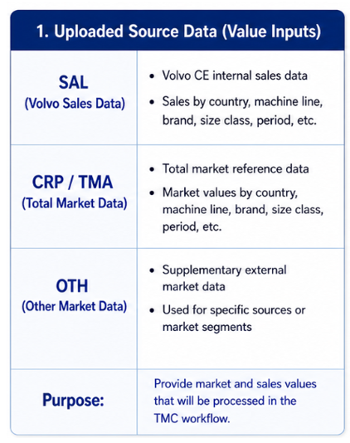
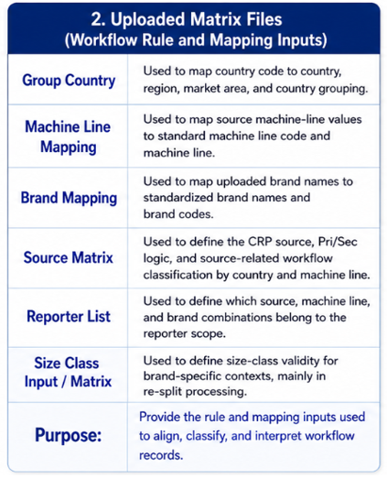
TMC Functional Modules (Input)

Slide 3
TMC Functional Modules (Execution Steps 1)
1. Preparation
OTH/SAL/TMA Run Control | Trigger SQL workflows for OTH/ SAL,/TMA Read the latest uploaded dataset and standardize fields using group country, machine line mapping, and brand mapping rules. Generate clean intermediate datasets
CRP Deletion Flag | Rows with Machine Line Code = 390 are marked as deleted.
OTH Deletion/Reporter Flag | Rows are deleted if Machine Line Code = 390 or if Country + Artificial Machine Line is not found in the Source Matrix. Assign Reporter Flag = Y when the derived CRP source matches Reporter List by source_code + artificial_machine_line + brand_code
Combination | Merge prepared CRP, OTH, and TMA fields into a unified control-report base for downstream processing.

Slide 4
TMC Functional Modules (Execution Steps 2)
2. Calculation
Market View | Show prepared TMA, calculate VCE from valid Volvo/SAL rows, and derive Non-Volvo CE = max(TMA - VCE, 0).
Adjustment Layer | Consolidate prepared SAL and TMA rows into reviewable adjustment output.
Machine Line Split Layer | Split adjusted results into machine-line level output. Apply split rules by machine-line structure and case-specific logic for downstream calculation.
Total Market Calculation | Resolve eligible OTH rows and double-brand cases to build total market.
Restatement | Rebalance brand-level results so they remain consistent with total market.
TMC Validation Report | TMC Validation Report (Country / Artificial Machine Line / Size Class Summary)
Final Report TBD...

Slide 5
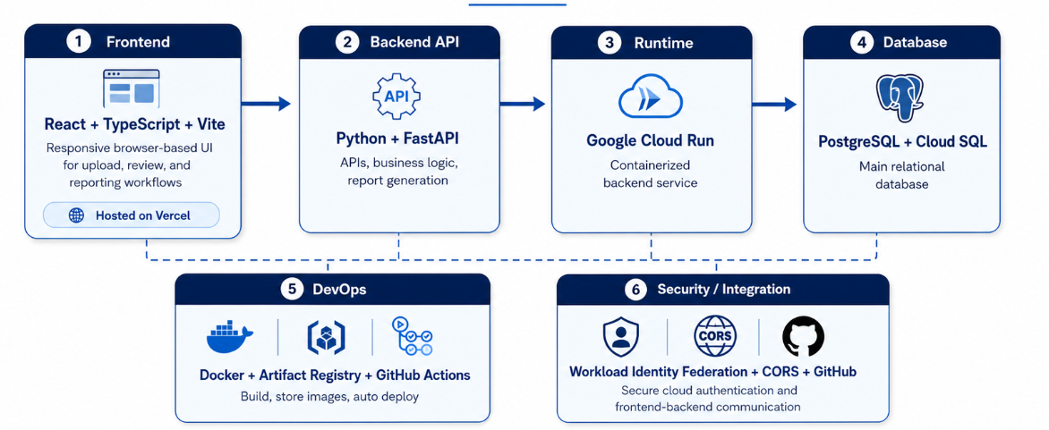


TMC Development Technologies
Development URL:
https://thesis-rust-five.vercel.app/
Repository:
https://github.com/YanxiangDu2023/thesis
(private repo)

Slide 6
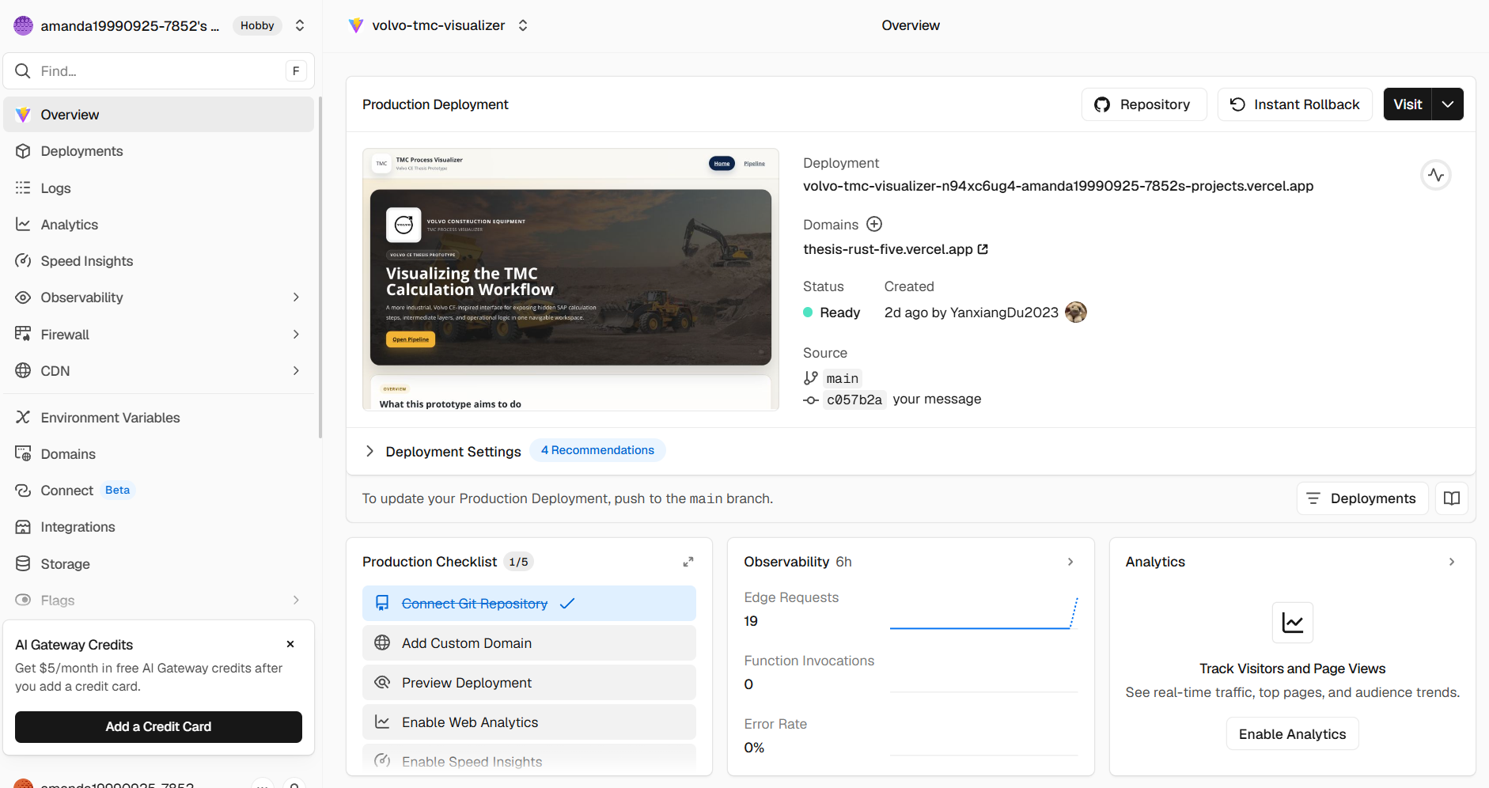
TMC Frontend
Vercel is used to host and deploy the React/Vite frontend.
The GitHub repository is connected to Vercel, so each push to the selected branch can automatically trigger a frontend deployment.
Frontend/vercel.json file defines how Vercel serves the frontend application, including routing for the built site.
After deployment, Vercel publishes the frontend as a live web application with a public domain.
Frontend/src/api/client.ts reads VITE_API_BASE_URL in client.ts to decide where API requests should be sent. In this project, it points to the FastAPI backend hosted on Google Cloud Run.

Slide 7
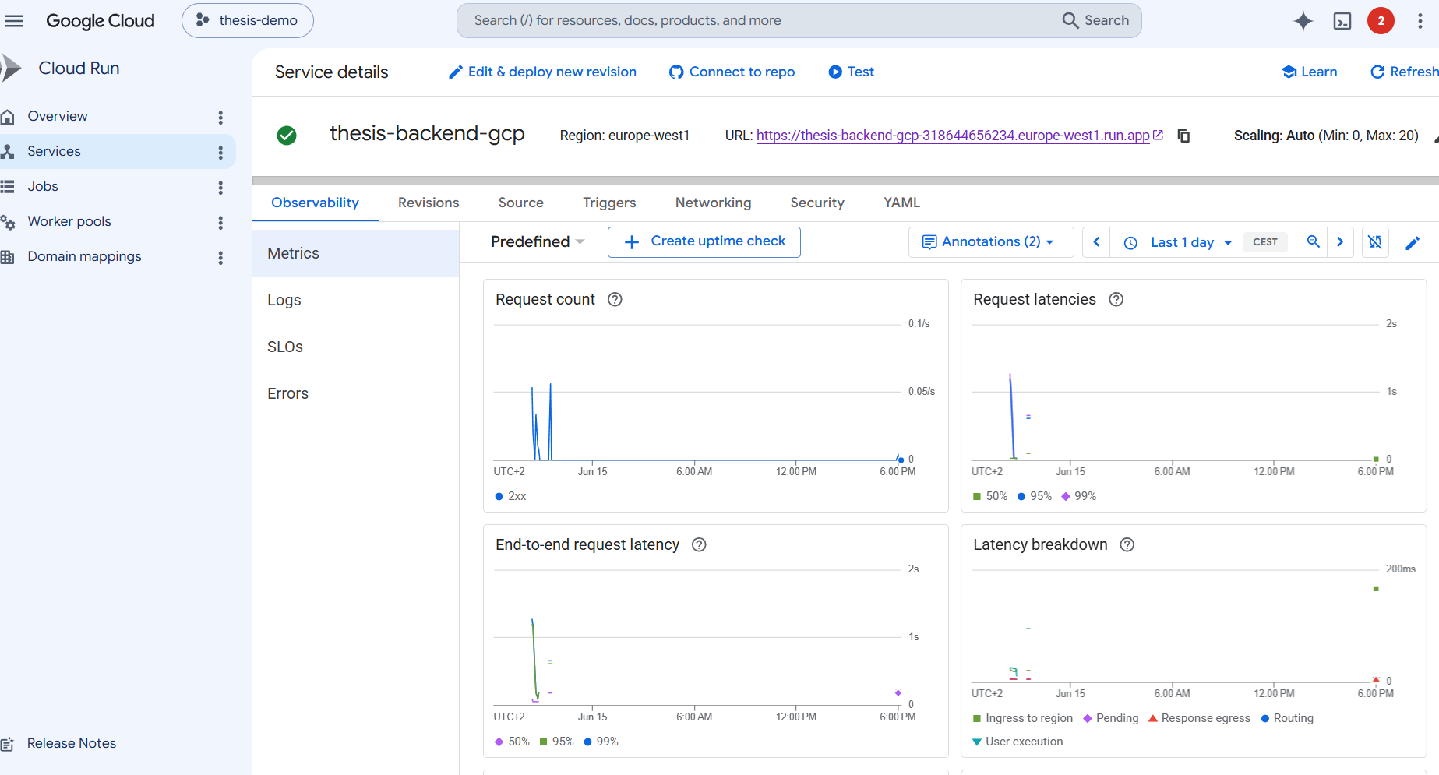
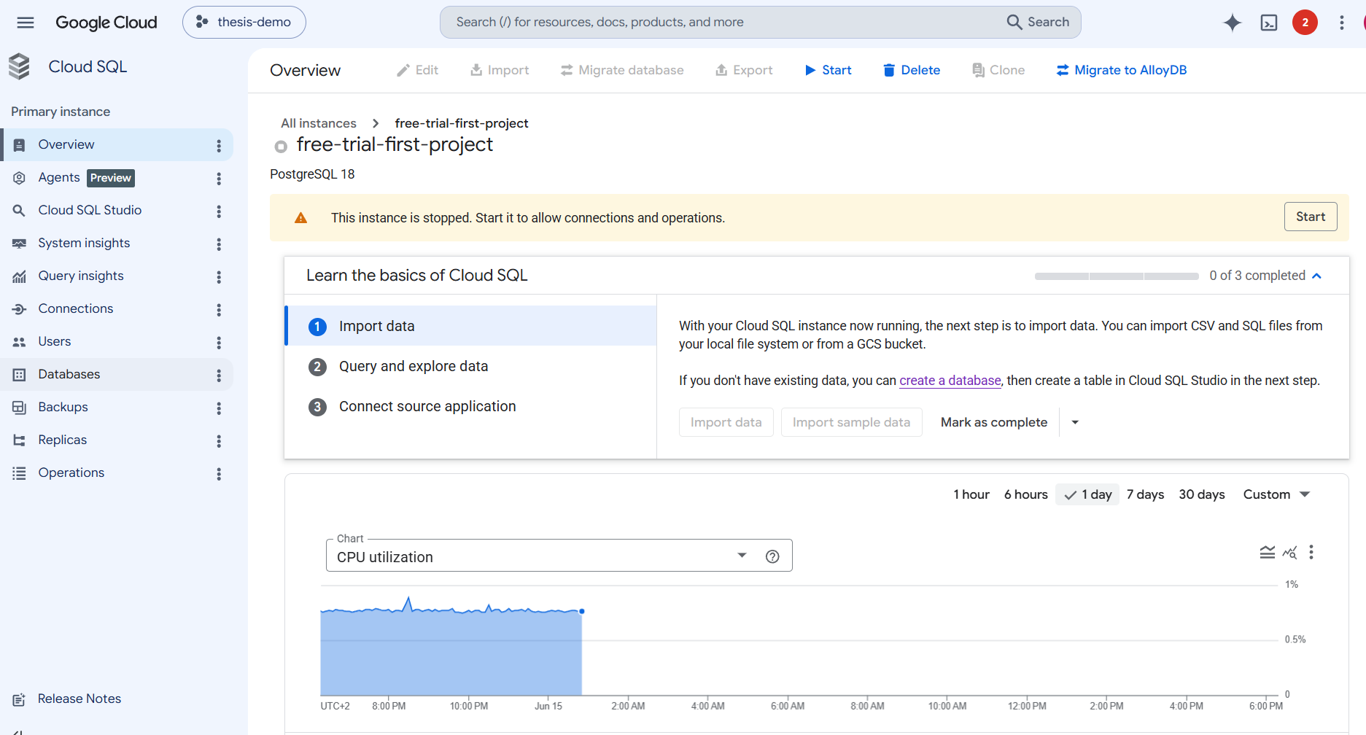
TMC Backend
Backend on Google Cloud Run
The FastAPI backend is deployed on Google Cloud Run.
It handles API endpoints, authentication, business logic, and database operations.
DATABASE_URL tells the backend which database to connect to.
backend/app/database.py establishes the actual database connection.
Backend router files, such as backend/app/routers/uploads.py, read from and write to the database tables.
Database on Google Cloud SQL PostgreSQL
Google Cloud SQL provides the managed database service.
PostgreSQL is the database engine running inside Cloud SQL.
backend/app/init_db.py defines and creates the required application tables.
These tables store uploads, mapping rules, report outputs, and workflow data.
The backend uses these tables for persistent storage and downstream processing.

Slide 8
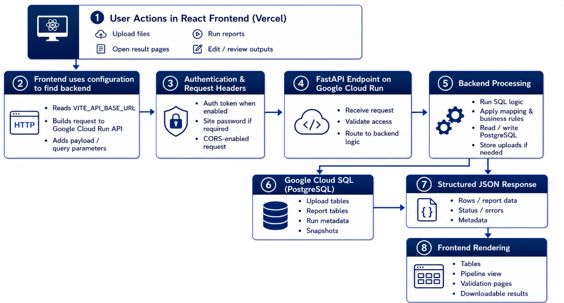
TMC Frontend-Backend Interaction
The Vercel-hosted React frontend connects to the FastAPI backend on Cloud Run.
The backend handles business logic and stores data in PostgreSQL on Google Cloud SQL.

Slide 9
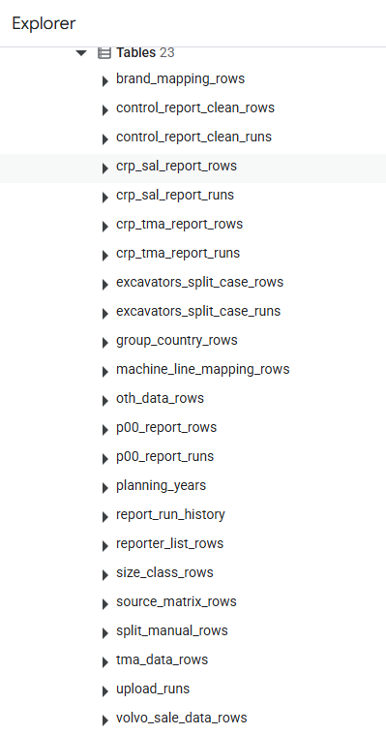
TMC Main Database Tables
Category | Tables | Main Purpose
Upload & Process Control | upload_runs, planning_years, report_run_history | Manage upload metadata, planning years, and report execution history.
Master Data / Mapping Rules | source_matrix_rows, brand_mapping_rows, machine_line_mapping_rows, group_country_rows, size_class_rows, reporter_list_rows | Store reference rules used for country, source, machine line, brand, size class, and reporter matching.
Raw Input Data | oth_data_rows, volvo_sale_data_rows, tma_data_rows | Store uploaded raw data from OTH, Volvo sales, and TMA sources.
Manual Adjustment | split_manual_rows | Store manual split/resplit adjustments for specific machine-line cases.
Report Output & Run Results | control_report_clean_runs, control_report_clean_rows, crp_sal_report_runs, crp_sal_report_rows, crp_tma_report_runs, crp_tma_report_rows, p00_report_runs, p00_report_rows, excavators_split_case_runs, excavators_split_case_rows | Store generated report runs and detailed output rows for validation, tracking, and downstream processing.
Most reports are regenerated from the latest successful uploads, while multi-step editable workflows such as split/resplit, total market calculation, and restatement continue from the latest saved snapshot. (eg. excavators_split_case_rows)

Slide 10
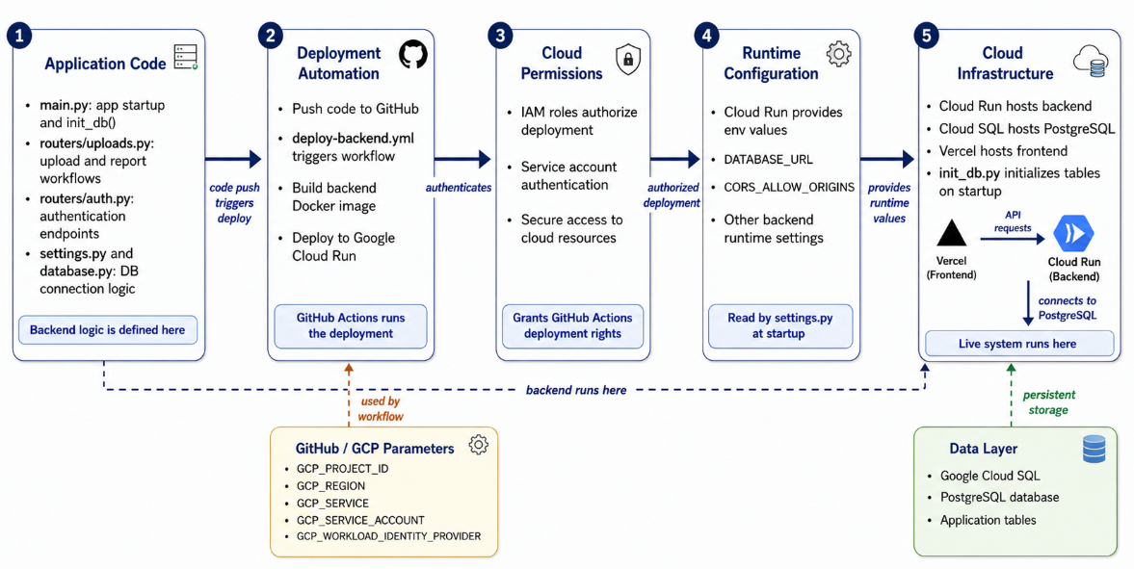
TMC Deployment Process

Slide 11

THANKS
Volvo Construction Equipment | Strategy & Business development| Madeleine Broberg| Internal
2026-06-15

Slide 12
TMC Cloud Run Cost and Open Points
1. Authentication is still lightweight
The current login mechanism supports basic password-based authentication and session tokens, but it does not yet include stronger security features such as MFA / 2FA.
2. Cloud cost control still needs improvement
The current deployment on Google Cloud still requires better cost management. At this stage, the database instance can be temporarily stopped when not in use, and instance downsizing will be considered later before restarting it for further testing or demonstration.
3. High concurrency has not been fully evaluated
The current system is designed for functional correctness and workflow support, but high-concurrency performance has not yet been thoroughly tested. It is also still unclear whether the actual business scenario requires strong concurrent load handling.
4. Some business rules are not fully validated yet
Certain domain-specific processing rules are still under confirmation. For example, cases such as how to handle OTH non-reporter brand logic are not yet fully finalized, so some report behaviors may still need business-side verification.

Slide 13
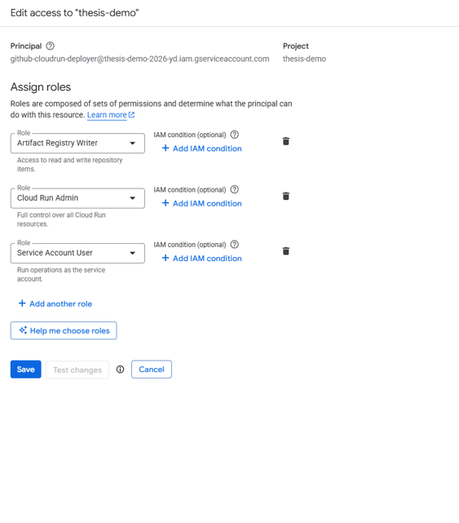
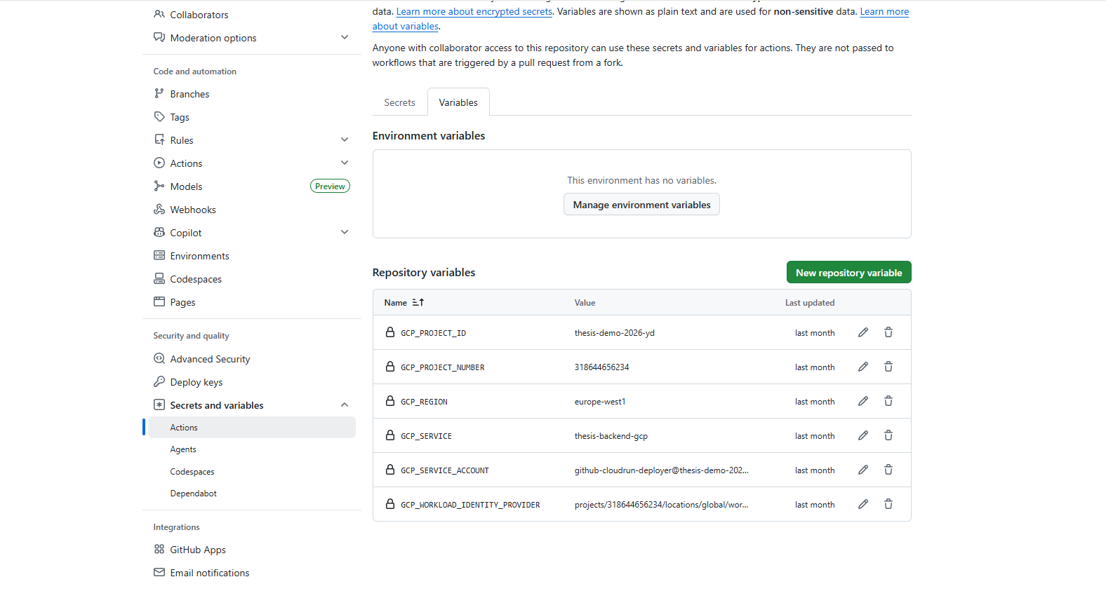
Deployment and CI/CD Process
1. Code changes are pushed to the main branch in GitHub.
2. GitHub Actions triggers the backend deployment workflow automatically when backend files are updated.
3. The workflow authenticates to Google Cloud through Workload Identity Federation rather than using a personal Google account directly.
4. Google Cloud verifies the GitHub workflow identity through the configured Workload Identity Provider and allows it to impersonate the deployment service account.
5. The backend Docker image is built and pushed to Google Artifact Registry.
6. The new image is then deployed to the Cloud Run service, which creates a new revision automatically.
This creates a secure and repeatable deployment pipeline linking GitHub, Artifact Registry, Cloud Run, and Cloud SQL.

Slide 16
Main Database Tables
Upload tracking tables: upload_runs and planning_years record file upload history, processing status, and yearly data scope.
Master data tables: source_matrix_rows, reporter_list_rows, size_class_rows, brand_mapping_rows, group_country_rows, and machine_line_mapping_rows store reference mappings used by the workflow.
Input data tables: oth_data_rows, volvo_sale_data_rows, and tma_data_rows store the major uploaded business datasets.
Manual adjustment table: split_manual_rows stores manual split inputs and corrections for selected machine-line cases.
Report output tables: control_report_clean_runs/rows, crp_tma_report_runs/rows, crp_sal_report_runs/rows, and p00_report_runs/rows store generated report results and snapshots.
Process trace tables: report_run_history and excavators_split_case_runs/rows preserve run history, reusable snapshots, and auditability of intermediate outputs.

Slide 17
Frontend-Backend Interaction
1. The user performs actions in the React frontend, such as logging in, uploading files, running reports, or opening result pages.
2. The frontend sends HTTP requests to FastAPI endpoints on Cloud Run through the configured API base URL.
3. Authentication tokens and the site password are attached in request headers when protected APIs are called.
4. The backend validates access, processes business logic, reads or writes PostgreSQL data, and stores uploaded files when needed.
5. The backend returns structured JSON responses, which the frontend renders as tables, pipeline views, validation pages, and downloadable results.
This interaction model separates presentation logic from business logic while keeping the system modular and easier to maintain.

Slide 19
Development Technologies
Frontend: React, TypeScript, and Vite were used to build a responsive browser-based interface for upload, review, and reporting workflows.
Frontend deployment: the web interface is deployed on Vercel for fast delivery and easy iteration.
Backend: Python and FastAPI were used to implement APIs, business logic, and report generation functions.
Backend runtime: the backend service is deployed on Google Cloud Run using containerized delivery.
Database: PostgreSQL is used as the main relational database, hosted through Google Cloud SQL.
DevOps and deployment: Docker is used for containerization, Google Artifact Registry stores images, and GitHub Actions handles automatic deployment.
Cloud authentication: Workload Identity Federation with a GCP service account is used so GitHub Actions can deploy securely without long-lived static credentials.
Cross-origin and source control: CORS is configured for frontend-backend communication, and GitHub is used for source code management.
Deployment URL: https://thesis-rust-five.vercel.app/
GitHub repository: https://github.com/YanxiangDu2023/thesis

Slide 20
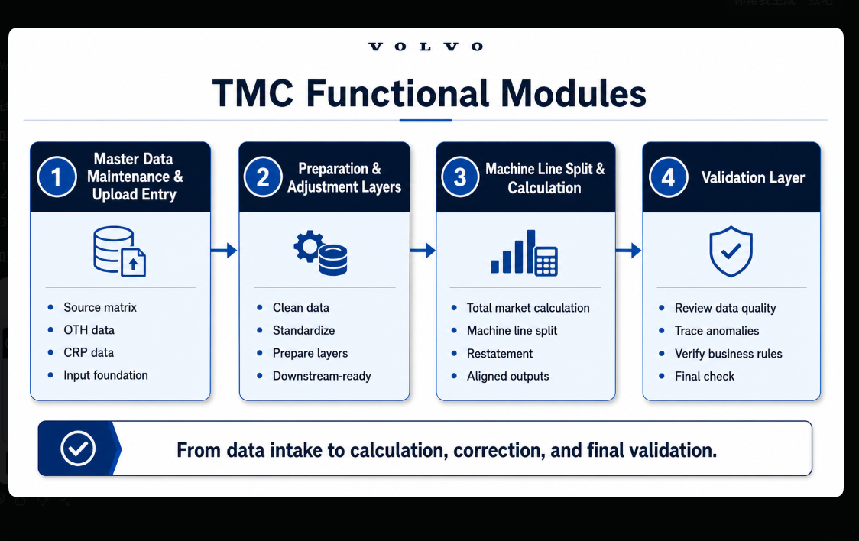

Slide 21
TMC Functional Modules
1. Master Data Maintenance and Upload Entry
users submit source matrix files, OTH data, and CRP data to establish the core input foundation for the workflow.
Master Data Maintenance and Upload Entry: users submit source matrix files, OTH data, and CRP data to establish the core input foundation for the workflow.
2. Preparation and Adjustment Layers: raw uploaded data is cleaned, standardized, and transformed into prepared and adjustment layers for downstream calculations.
3. Machine Line Split and Calculation: the system performs total market calculation, machine line split logic, and restatement processing to generate aligned market outputs.
4. Validation Layer: the TMC validation report is used to review data quality, trace anomalies, and verify whether calculated outputs are consistent with business rules.
Overall, each module supports a clear progression from data intake to calculation, correction, and final validation.

Slide 22
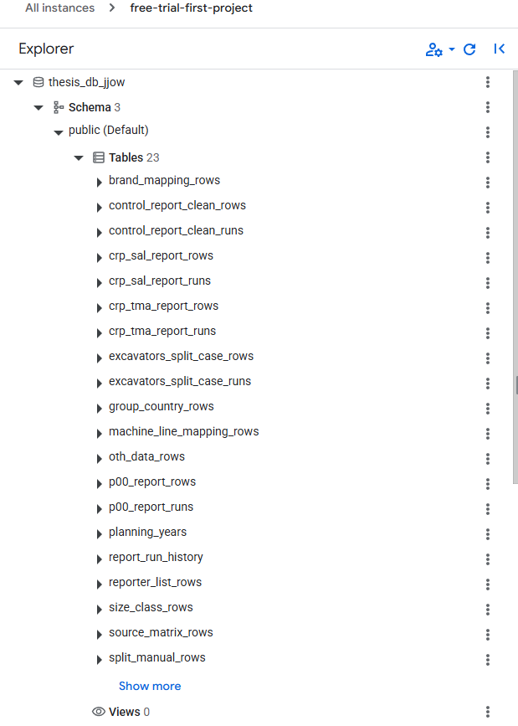
Main Database Tables
Upload tracking tables: upload_runs and planning_years record file upload history, processing status, and yearly data scope.
Master data tables: source_matrix_rows, reporter_list_rows, size_class_rows, brand_mapping_rows, group_country_rows, and machine_line_mapping_rows store reference mappings used by the workflow.
Input data tables: oth_data_rows, volvo_sale_data_rows, and tma_data_rows store the major uploaded business datasets.
Manual adjustment table: split_manual_rows stores manual split inputs and corrections for selected machine-line cases.
Report output tables: control_report_clean_runs/rows, crp_tma_report_runs/rows, crp_sal_report_runs/rows, and p00_report_runs/rows store generated report results and snapshots.
Process trace tables: report_run_history and excavators_split_case_runs/rows preserve run history, reusable snapshots, and auditability of intermediate outputs.

Slide 23
Frontend-Backend Interaction
1. The user performs actions in the React frontend, such as logging in, uploading files, running reports, or opening result pages.
2. The frontend sends HTTP requests to FastAPI endpoints on Cloud Run through the configured API base URL.
3. Authentication tokens and the site password are attached in request headers when protected APIs are called.
4. The backend validates access, processes business logic, reads or writes PostgreSQL data, and stores uploaded files when needed.
5. The backend returns structured JSON responses, which the frontend renders as tables, pipeline views, validation pages, and downloadable results.
This interaction model separates presentation logic from business logic while keeping the system modular and easier to maintain.

Slide 24
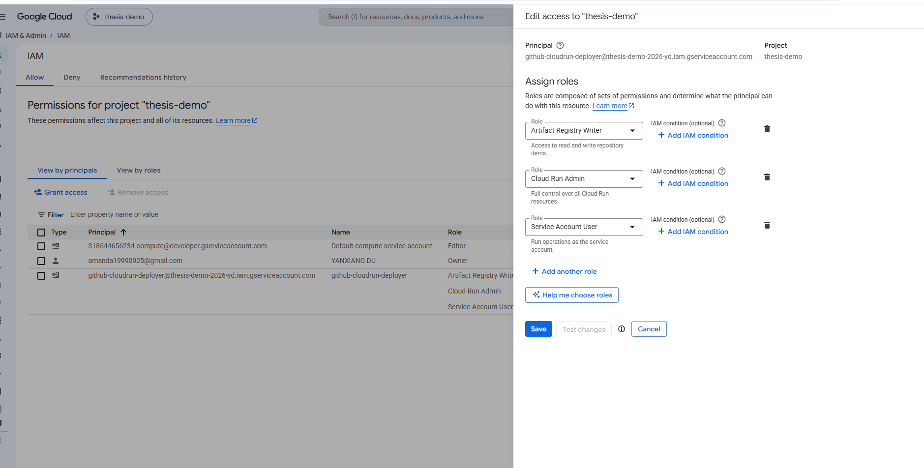
Deployment and CI/CD Process
1. Code changes are pushed to the main branch in GitHub.
2. GitHub Actions triggers the backend deployment workflow automatically when backend files are updated.
3. The workflow authenticates to Google Cloud through Workload Identity Federation rather than using a personal Google account directly.
4. Google Cloud verifies the GitHub workflow identity through the configured Workload Identity Provider and allows it to impersonate the deployment service account.
5. The backend Docker image is built and pushed to Google Artifact Registry.
6. The new image is then deployed to the Cloud Run service, which creates a new revision automatically.
This creates a secure and repeatable deployment pipeline linking GitHub, Artifact Registry, Cloud Run, and Cloud SQL.

Slide 25
Cloud Run Cost and Open Points
Cloud Run follows a pay-for-usage model, so cost depends on request count, execution time, CPU allocation, memory size, and egress traffic rather than a fixed server price.
This is suitable for the thesis system because backend workloads are irregular and can scale down when there is no active use.
Main cost-related components in the current architecture include Cloud Run, Cloud SQL, Artifact Registry storage, and network traffic.
For practical operation, cost can be reduced by keeping the service lightweight, limiting unnecessary revisions, and optimizing report execution time.
Open implementation point: the handling of validation and non-reporter brand logic is still being finalized and should be clarified in the next iteration of the system.

Slide 26
THANKS
Volvo Construction Equipment | Strategy & Business development| Madeleine Broberg| Internal
2026-06-15

Slide 27

MC Matrixes
Size class flag
Reporters
Source matrix
Bulkchart + Participation history
TM North America
TM Hargrove worldwide
TM European
Country groupings
ICEMA
Manual corrections/ CCMA
TM shipments
Brands
Global BI | TMC 20251 Market Share & Competitor evolution| Madeleine Broberg | Confidential - for internal use only
11 November 2022

